Slide 1
URMA 2012 Panel:
Online Publishing
Rachel Coker
Director of Research Advancement
Binghamton University

Slide 2
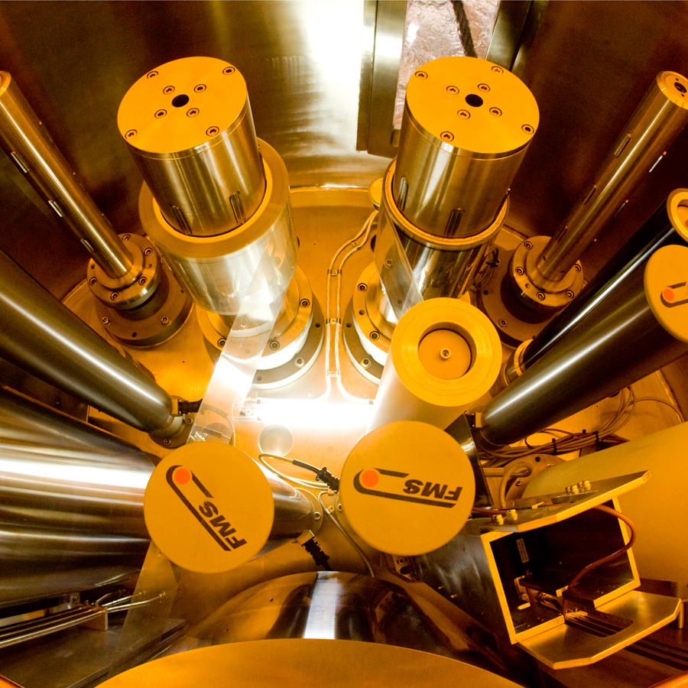

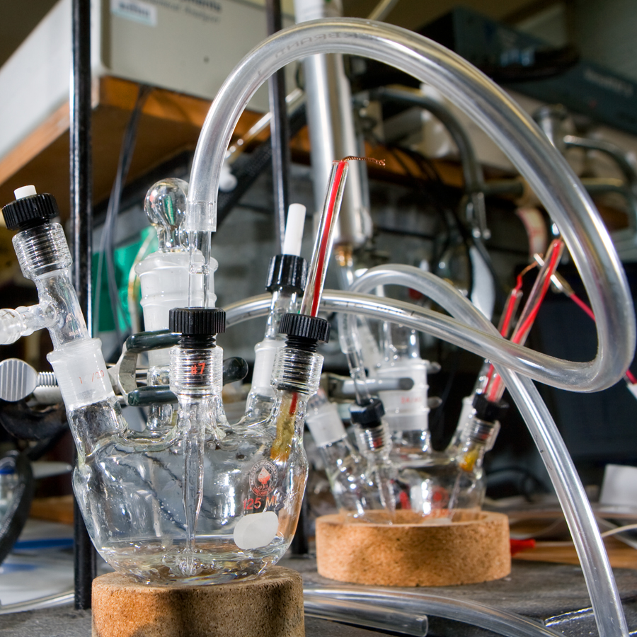
Binghamton University has sponsored research of slightly less than $40M per year.
We’re a public university in upstate New York with
a reputation for an excellent and affordable
undergraduate education.
We need to boost our profile
as a research institution.

Slide 3
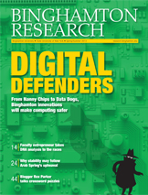
How do we promote our research?
A print magazine, which moved to twice-annual publication in 2011 after more than 10 years as an annual project.
A research news website, redesigned at the end of 2009 and tweaked a few times since.
A twice-monthly e-mail.
Social media through main
University streams.

Slide 4
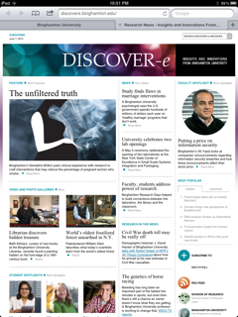
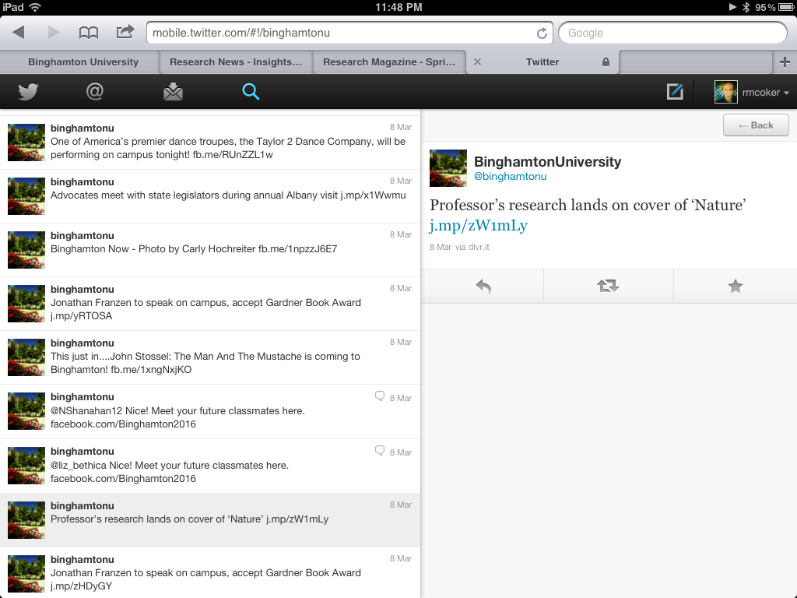
Discover-e and social media

Slide 5
What’s new?
In spring 2011, we added a digital edition of the research magazine. We had created flipbooks through Issuu (an excellent free service), but this allows for embedded videos and hot links within the publication.
In December 2011, we launched an
iPad app called B-Reader.
We redesigned our research home page. It now
includes an RSS feed with headlines
from our news website.

Slide 6
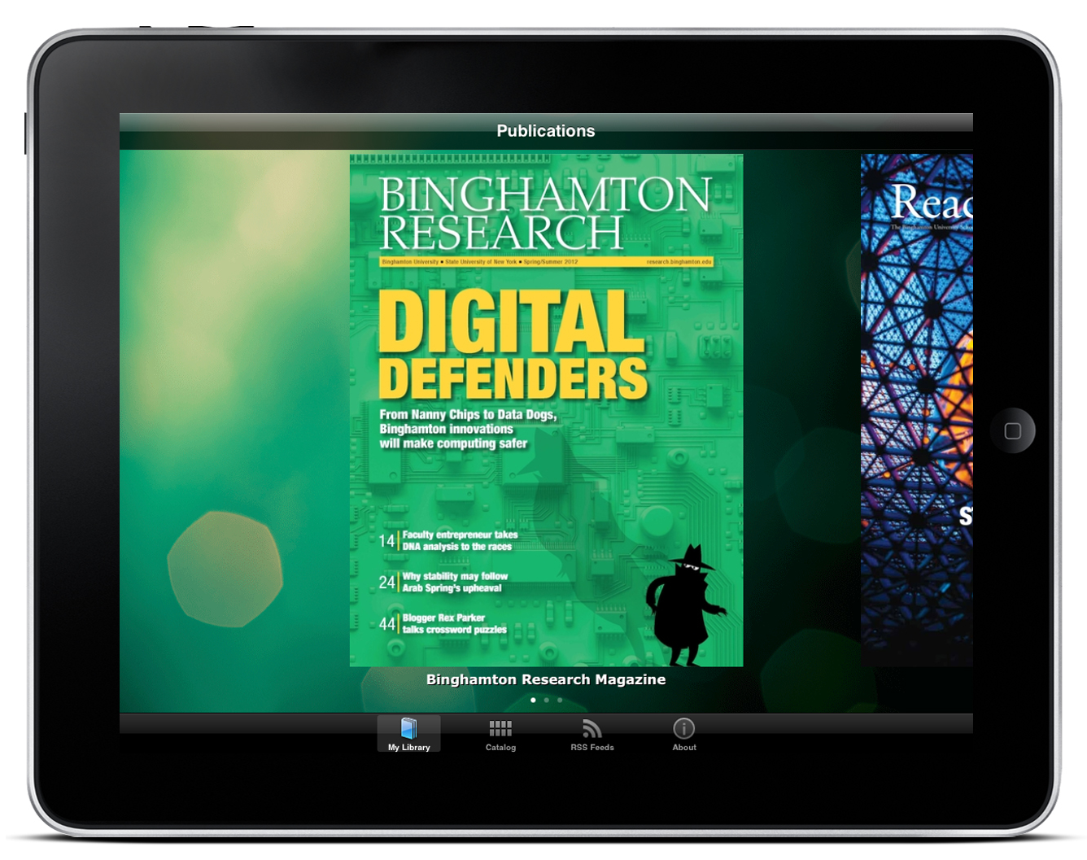

B-Reader
B-Reader

Slide 7
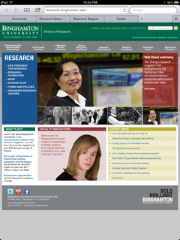
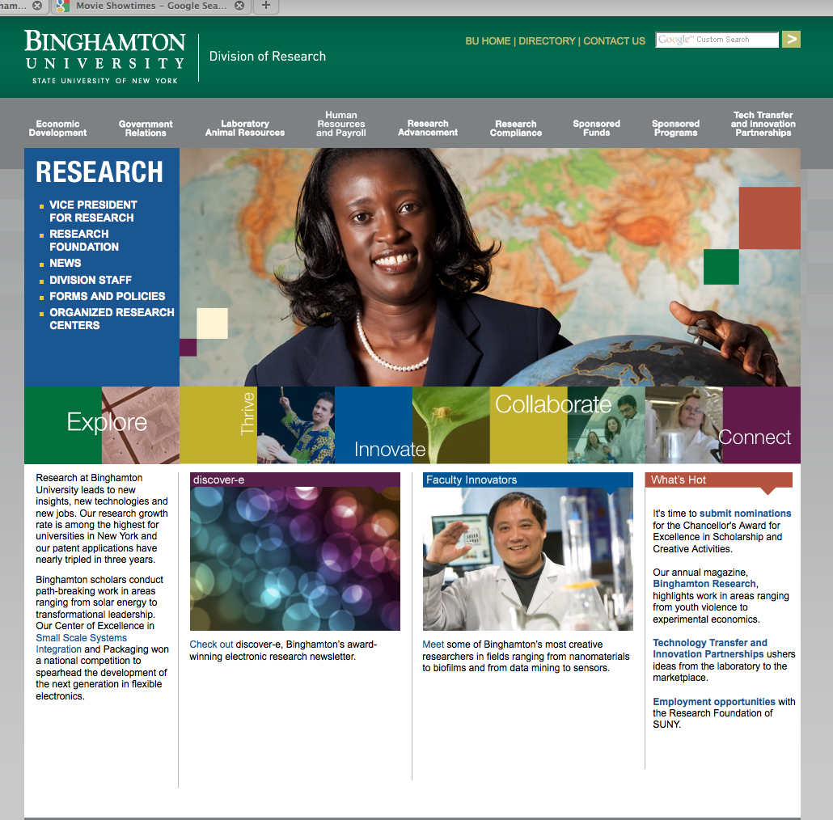
Home page, now (and then)

Slide 8
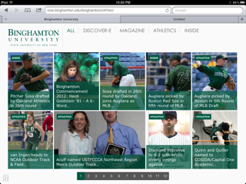
What’s next?
Something done in HTML5, perhaps!

Slide 9
Questions?
E-mail: rcoker@binghamton.edu
Twitter: @rmcoker
Phone: 607-777-6135

